Slide 1
NMI IRQ
FIRQ RST
JMP
EA → PC
Memory
Bus
BRA
M → Temp
PC + Temp → PC
Bus
Address
PC
Control
Unit
Microcode
BNE
M → Temp
IF Z = 0
PC + Temp → PC
Data
Fetch
IDX
Decoder
Registers
Data
Write
Operand 0
Operand 1
ALU

Slide 2
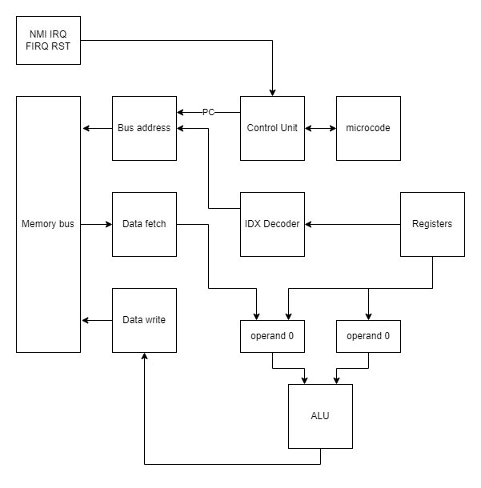
NMI IRQ
FIRQ RST
ADD 8bits
R + M → R
R → op1, M → op0
op0 + op1 → AluOut
AluOut → R
ADDD 16bits
R + M:M + 1 → R
R → op0 ; R1 → op2
op0 + op1 → AluOut
AluOut
Memory
Bus
Bus
Address
Control
Unit
Microcode
Data
Fetch
IDX
Decoder
Registers
Data
Write
Operand 0
Operand 1
ALU

Slide 3
NMI IRQ
FIRQ RST
CMP 8bits
R - M → Temp
CMP 16bits
R - M:M + 1 → Temp
Memory
Bus
Bus
Address
Control
Unit
Microcode
Data
Fetch
IDX
Decoder
Registers
Data
Write
Operand 0
Operand 1
ALU
Temp

Slide 4
NMI IRQ
FIRQ RST
Memory
Bus
Bus
Address
Control
Unit
Microcode
Data
Fetch
IDX
Decoder
Registers
Data
Write
Operand 0
Operand 0
ALU

Slide 5
NMI IRQ
FIRQ RST
Memory
Bus
Bus
Address
Control
Unit
Microcode
Data
Fetch
IDX
Decoder
Registers
Data
Write
Operand 0
Operand 0
ALU

Slide 6
NMI IRQ
FIRQ RST
Memory
Bus
Bus
Address
Control
Unit
Microcode
Data
Fetch
IDX
Decoder
Registers
Data
Write
Operand 0
Operand 0
ALU

Slide 7
NMI IRQ
FIRQ RST
Memory
Bus
Bus
Address
Control
Unit
Microcode
Data
Fetch
IDX
Decoder
Registers
Data
Write
Operand 0
Operand 0
ALU

